Slide 1

Software Testing
Sana Rizwan
Assistant Professor
Department of Computer Science, CUI Lahore

Slide 2
Chapter 3 – Testing in software life cycle

Slide 3
6 Types of Software Testing Models
1. Waterfall Model
Advantages
Easy to implement and maintain.
The initial phase of rigorous scrutiny of requirements and systems helps in saving time later in the developmental phase
The requirement of resources is minimal and testing is done after completion of each phase.
Disadvantages
It is not possible to alter or update requirements
You cannot make changes once you are into the next phase.
Cannot start the next phase until the previous phase is completed

Slide 4
6 Types of Software Testing Models
2. V-Model
Advantages
Easy to use the model since testing activities like planning and test designing are done before coding
Saves time and enhances chances of success.
Defects are mostly found at an early stage and downward flow of defects is generally avoided
Disadvantages
It is a rigid model
Early prototypes of the product are not available since the software is developed during the implementation phase
If there are changes in the midway, then the test document needs to be updated

Slide 5
6 Types of Software Testing Models
3 . Agile Model
Advantages
Ensure customer satisfaction with rapid and continuous development of deliverables.
It is a flexible model as customers, developers and testers continuously interact with each other
Working software can be developed quickly and product can be adapted to changing requirements regularly
Disadvantages
In large and complex software development cases it becomes difficult to assess the effort required at the beginning of the cycle
Due to continuous interaction with the customer, the project can go off track if the customer is not clear about the goals

Slide 6
6 Types of Software Testing Models
4. Spiral Model
Advantages
Risk avoidance chance is enhanced due to the importance on risk analysis.
Its a good model for complex and large systems.
Depending on the changed circumstances additional functionalities can be added later on
Software is produced early in the cycle
Disadvantages
Its a costly model and requires highly specialized expertise in risk analysis
It does not work well in simpler projects

Slide 7
6 Types of Software Testing Models
5. Rational Unified Process
Advantages
With an emphasis on accurate documentation this model is able to resolve risks associated with changing requirements of the client
Integration takes less time as the process goes on throughout the SDLC.
Disadvantages
The biggest disadvantage is that the team members need to be experts in their niche.
In big projects such continuous integration, it might give rise to confusions

Slide 8
6 Types of Software Testing Models
6. Rapid Application Development Process
Advantages
The development time is reduced due to simultaneous development of components and the components can be reused
A lot of integration issues are resolved due to integration from the initial stage.
Disadvantages
It requires a strong team of highly capable developers with individual efficacy in identifying business requirements
It is a module based model, so systems that can be modularized can only be developed in this model
As the cost is high, the model is not suitable for cheaper projects.

Slide 9
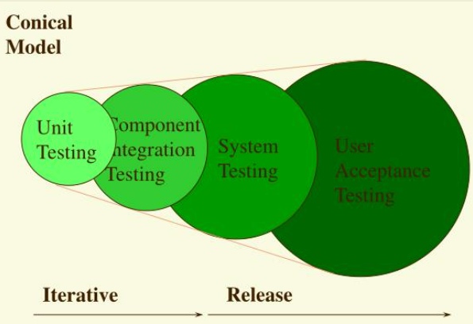
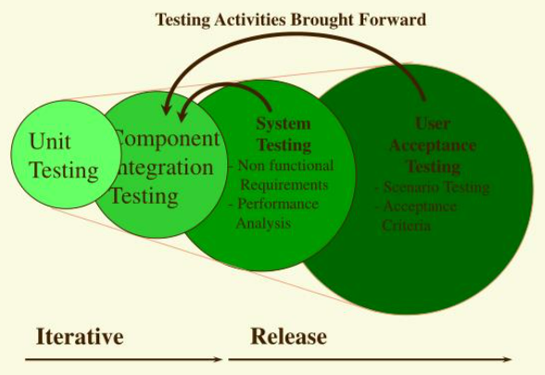
Software testing conical model

Slide 10
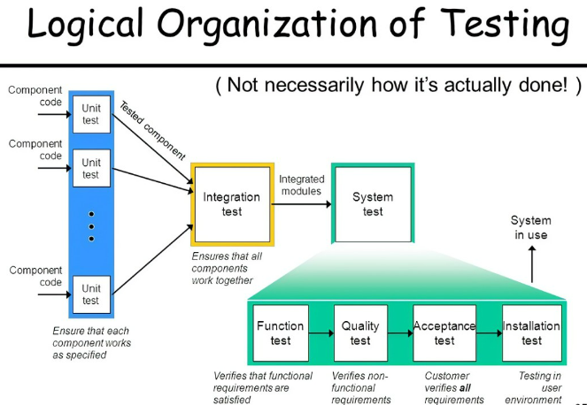
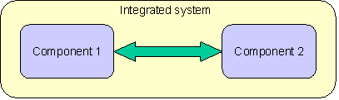
Component testing
Component testing is verifying and validating the functionality, performance, compliance to requirements for a particular component. This testing is limited to that particular component.

Slide 11
Component integration testing
It tests the interactions between software components and is done after component testing.
The software components themselves may be specified at different times by different specification groups, yet the integration of all of the pieces must work together.
It is important to cover negative cases as well because components might make assumption with respect to the data.

Slide 12
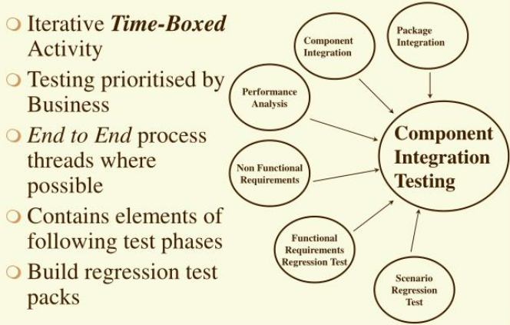
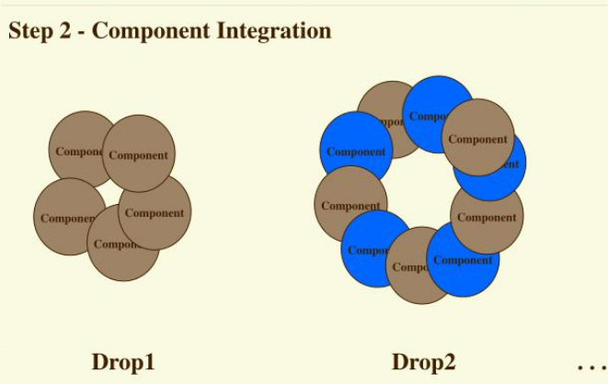
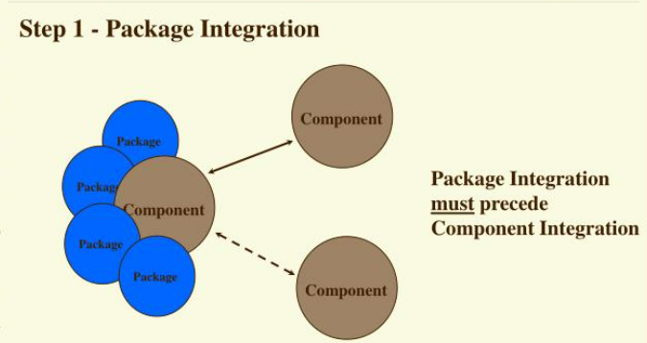
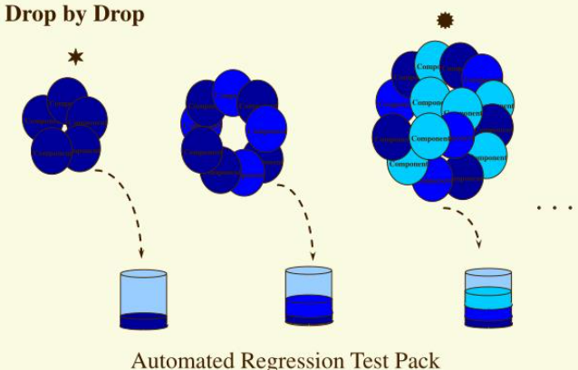

Slide 13
System Testing
It is very important to complete a full test cycle and ST is the stage where it is done.
ST is performed in an environment that is similar to the production environment and hence stakeholders can get a good idea of the user’s reaction.
It helps to minimize after-deployment troubleshooting and support calls.
In this STLC stage Application Architecture and Business requirements, both are tested.

Slide 14
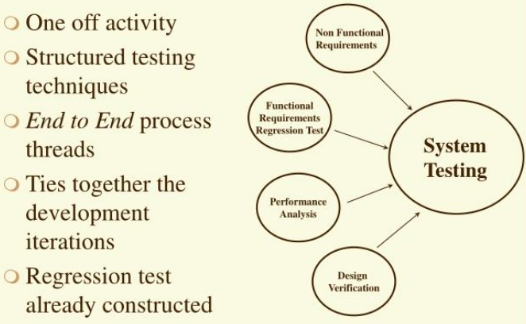
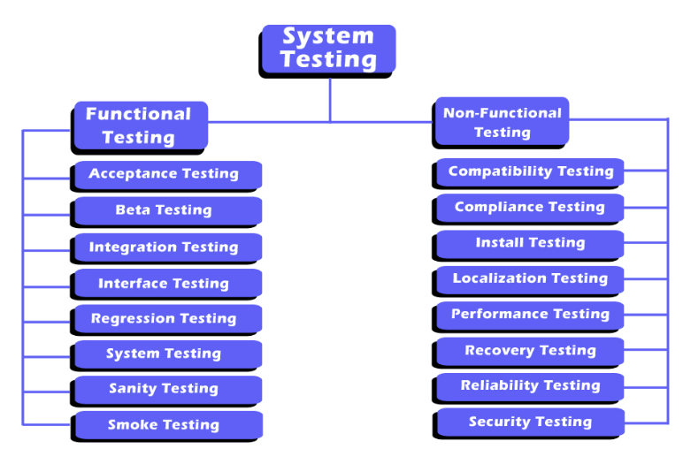
System Testing

Slide 15
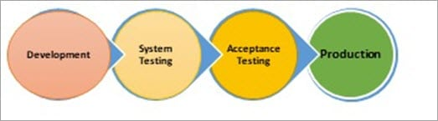
Acceptance Testing
Once the System Testing process is completed by the testing team and is signed-off, the entire Product/application is handed over to the customer/few users of customers/both, to test for its acceptability i.e., Product/application should be flawless in meeting both the critical and major Business requirements. Also, end-to-end business flows are verified like in a real-time scenarios.
This is a black-box testing technique where only the functionality is verified to ensure that the product meets the specified acceptance criteria (no need for design/implementation knowledge).
The production-like environment will be the testing environment for Accepting Testing (Usually termed as Staging, Pre-Prod, Fail-Over, UAT environment).

Slide 16
Why acceptance testing?
Though System testing has been completed successfully, the Acceptance test is demanded by the customer. Tests conducted here are repetitive, as they would have been covered in System testing.
Then, why is this testing is conducted by customers?
This is because:
To gain confidence in the product that is getting released to the market.
To ensure that the product is working in the way it has to.
To ensure that the product matches current market standards and is competitive enough with the other similar products in the market.

Slide 17
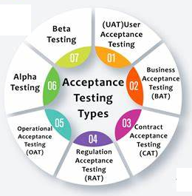
Types of acceptance testing
User Acceptance Testing (UAT)
Business Acceptance Testing (BAT)
Contract Acceptance Testing (CAT)
Regulations/Compliance Acceptance Testing (RAT)
Operational Acceptance Testing (OAT)
Alpha Testing
Beta Testing/Field Testing
For More Information MS Word File Link

Slide 18
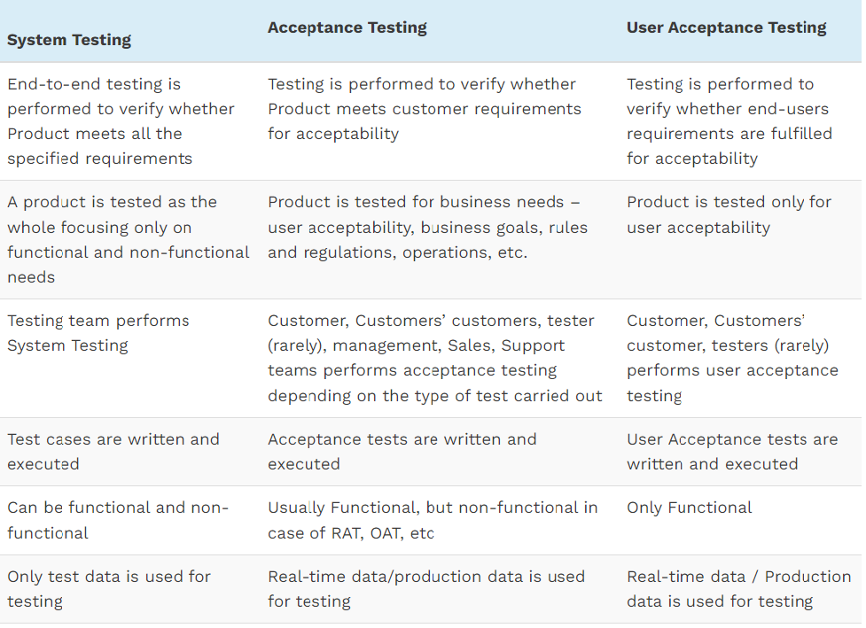
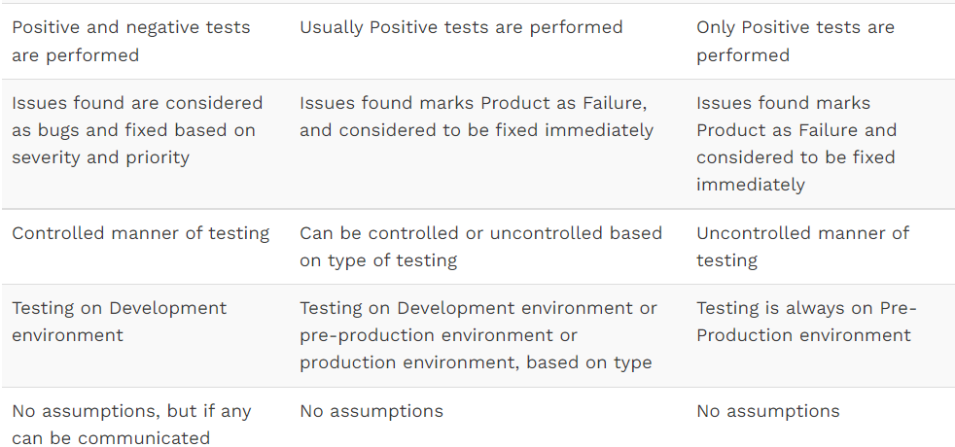
Differences between System Testing, Acceptance Testing, and User Acceptance Testing

Slide 19
Software Testing
Testing is the process of executing a program to find errors. To make our software perform well it should be error-free. If testing is done successfully it will remove all the errors from the software.
Principles of testing
(i) All the tests should meet the customer requirements. (ii) To make our software testing should be performed by a third party. (iii) Exhaustive testing is not possible. As we need the optimal amount of testing based on the risk assessment of the application. (iv) All the tests to be conducted should be planned before implementing it (v) It follows the Pareto rule(80/20 rule) which states that 80% of errors come from 20% of program components. (vi) Start testing with small parts and extend it to large parts.

Slide 20
Types of testing
1. Unit Testing
It focuses on the smallest unit of software design. In this, we test an individual unit or group of interrelated units. It is often done by the programmer by using sample input and observing its corresponding outputs.
Example:
In a program we are checking if the loop, method, or function is working fine.
Misunderstood or incorrect, arithmetic precedence.
Incorrect initialization .

Slide 21
Types of testing…
2. Integration Testing
The objective is to take unit-tested components and build a program structure that has been dictated by design. Integration testing is testing in which a group of components is combined to produce output.
Integration testing is of four types: (i) Top-down (ii) Bottom-up (iii) Sandwich (iv) Big-Bang
Example:
Black Box testing:- It is used for validation. In this, we ignore internal working mechanisms and focus on what is the output?.
White box testing:- It is used for verification. In this, we focus on internal mechanisms i.e. how the output is achieved?

Slide 22
Types of testing…
3. Regression Testing
Every time a new module is added leads to changes in the program. This type of testing makes sure that the whole component works properly even after adding components to the complete program.
Example
In school, record suppose we have module staff, students and finance combining these modules and checking if on integration of these modules works fine in regression testing

Slide 23
Types of testing…
4. Smoke Testing
This test is done to make sure that the software under testing is ready or stable for further testing. It is called a smoke test as the testing of an initial pass is done to check if it did not catch the fire or smoke in the initial switch on.
Example:
If the project has 2 modules so before going to the module make sure that module 1 works properly

Slide 24
Types of testing…
5. Alpha Testing
This is a type of validation testing. It is a type of acceptance testing which is done before the product is released to customers. It is typically done by QA people.
Example:
When software testing is performed internally within the organization

Slide 25
Types of testing…
6. Beta Testing
The beta test is conducted at one or more customer sites by the end-user of the software. This version is released for a limited number of users for testing in a real-time environment
Example:
When software testing is performed for the limited number of people

Slide 26
Types of testing…
7. System Testing
This software is tested such that it works fine for the different operating systems. It is covered under the black box testing technique. In this, we just focus on the required input and output without focusing on internal working. In this, we have security testing, recovery testing, stress testing, and performance testing
Example:
This includes functional as well as nonfunctional testing

Slide 27
Types of testing…
8. Stress Testing
In this, we give unfavorable conditions to the system and check how they perform in those conditions.
Example:
Test cases that require maximum memory or other resources are executed
Test cases that may cause thrashing in a virtual operating system
Test cases that may cause excessive disk requirement

Slide 28
Types of testing…
9. Performance Testing
It is designed to test the run-time performance of software within the context of an integrated system. It is used to test the speed and effectiveness of the program. It is also called load testing. In it we check, what is the performance of the system in the given load.
Example:
Checking several processor cycles.

Slide 29
Types of testing…
10. Object-Oriented Testing
This testing is a combination of various testing techniques that help to verify and validate object-oriented software. This testing is done in the following manner:
Testing of Requirements
Design and Analysis of Testing
Testing of Code
Integration testing
System testing
User Testing

Slide 30

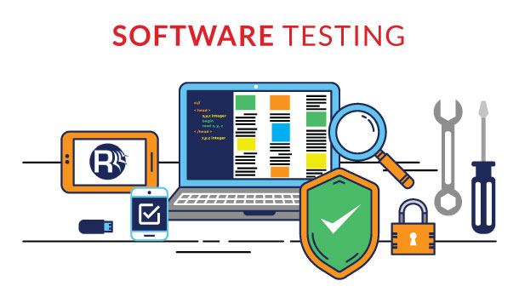

Any Questions

